Slide 1
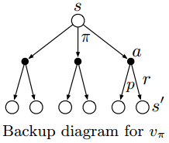
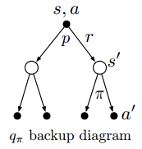

Slide 2
a_t
a_(t+1)
a_(t+n-1)
a_(t+n)
r_(t+1)
r_(t+2)
r_(t+n)
s_t
s_(t+1)
s_(t+n-1)
s_(t+n)

